Slide 1

Dynamics CRM/365 Development

Slide 2
What Is Dynamics CRM/365
Dynamics CRM is a Customer Relationship Management software product from Microsoft, based on .NET Framework
Highly customisable in terms of business logic and process through a number of development/customisation methods such as plugins, workflows and web resources using the CRM SDK
Limited however in certain aspects, no supported direct database updates, no editing of the application source code

Slide 3
Server-Side development
For Server-Side development, this is typically done through what are known as Plug-Ins. A plug-in is a custom business logic that integrates with Microsoft Dynamics CRM to modify or extend the standard behaviour of the platform. Plug-ins act as event handlers and are registered to execute on a particular event in CRM.
Plug-ins consist of C# methods that utilise the CRM SDK namespace to perform CRUD operations against the ‘Organisation Service’ which is the SOAP endpoint for CRM – (Soon to be replaced by Odata)

Slide 4
Client Side Development
Client side development for CRM is typically done through JavaScript. You can create ssociate functions with events on the form, most commonly Onload, OnSave, and OnChange.
Some of the most common methods would be setting visibility of fields, locking fields for editing, or setting values for fields.
You can also access other record data using the OData endpoint
Another common client side development is custom HTML resources. You cannot edit the HTML of CRM Web Pages directly, but you can insert custom iFrames etc

Slide 5
Demo

Slide 6
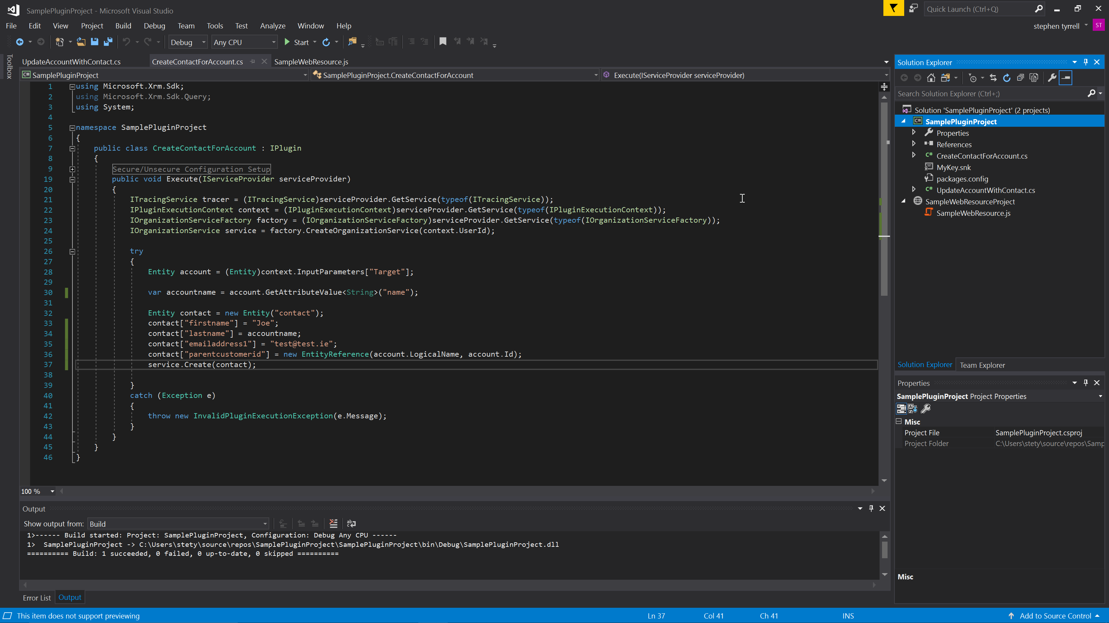

Slide 7
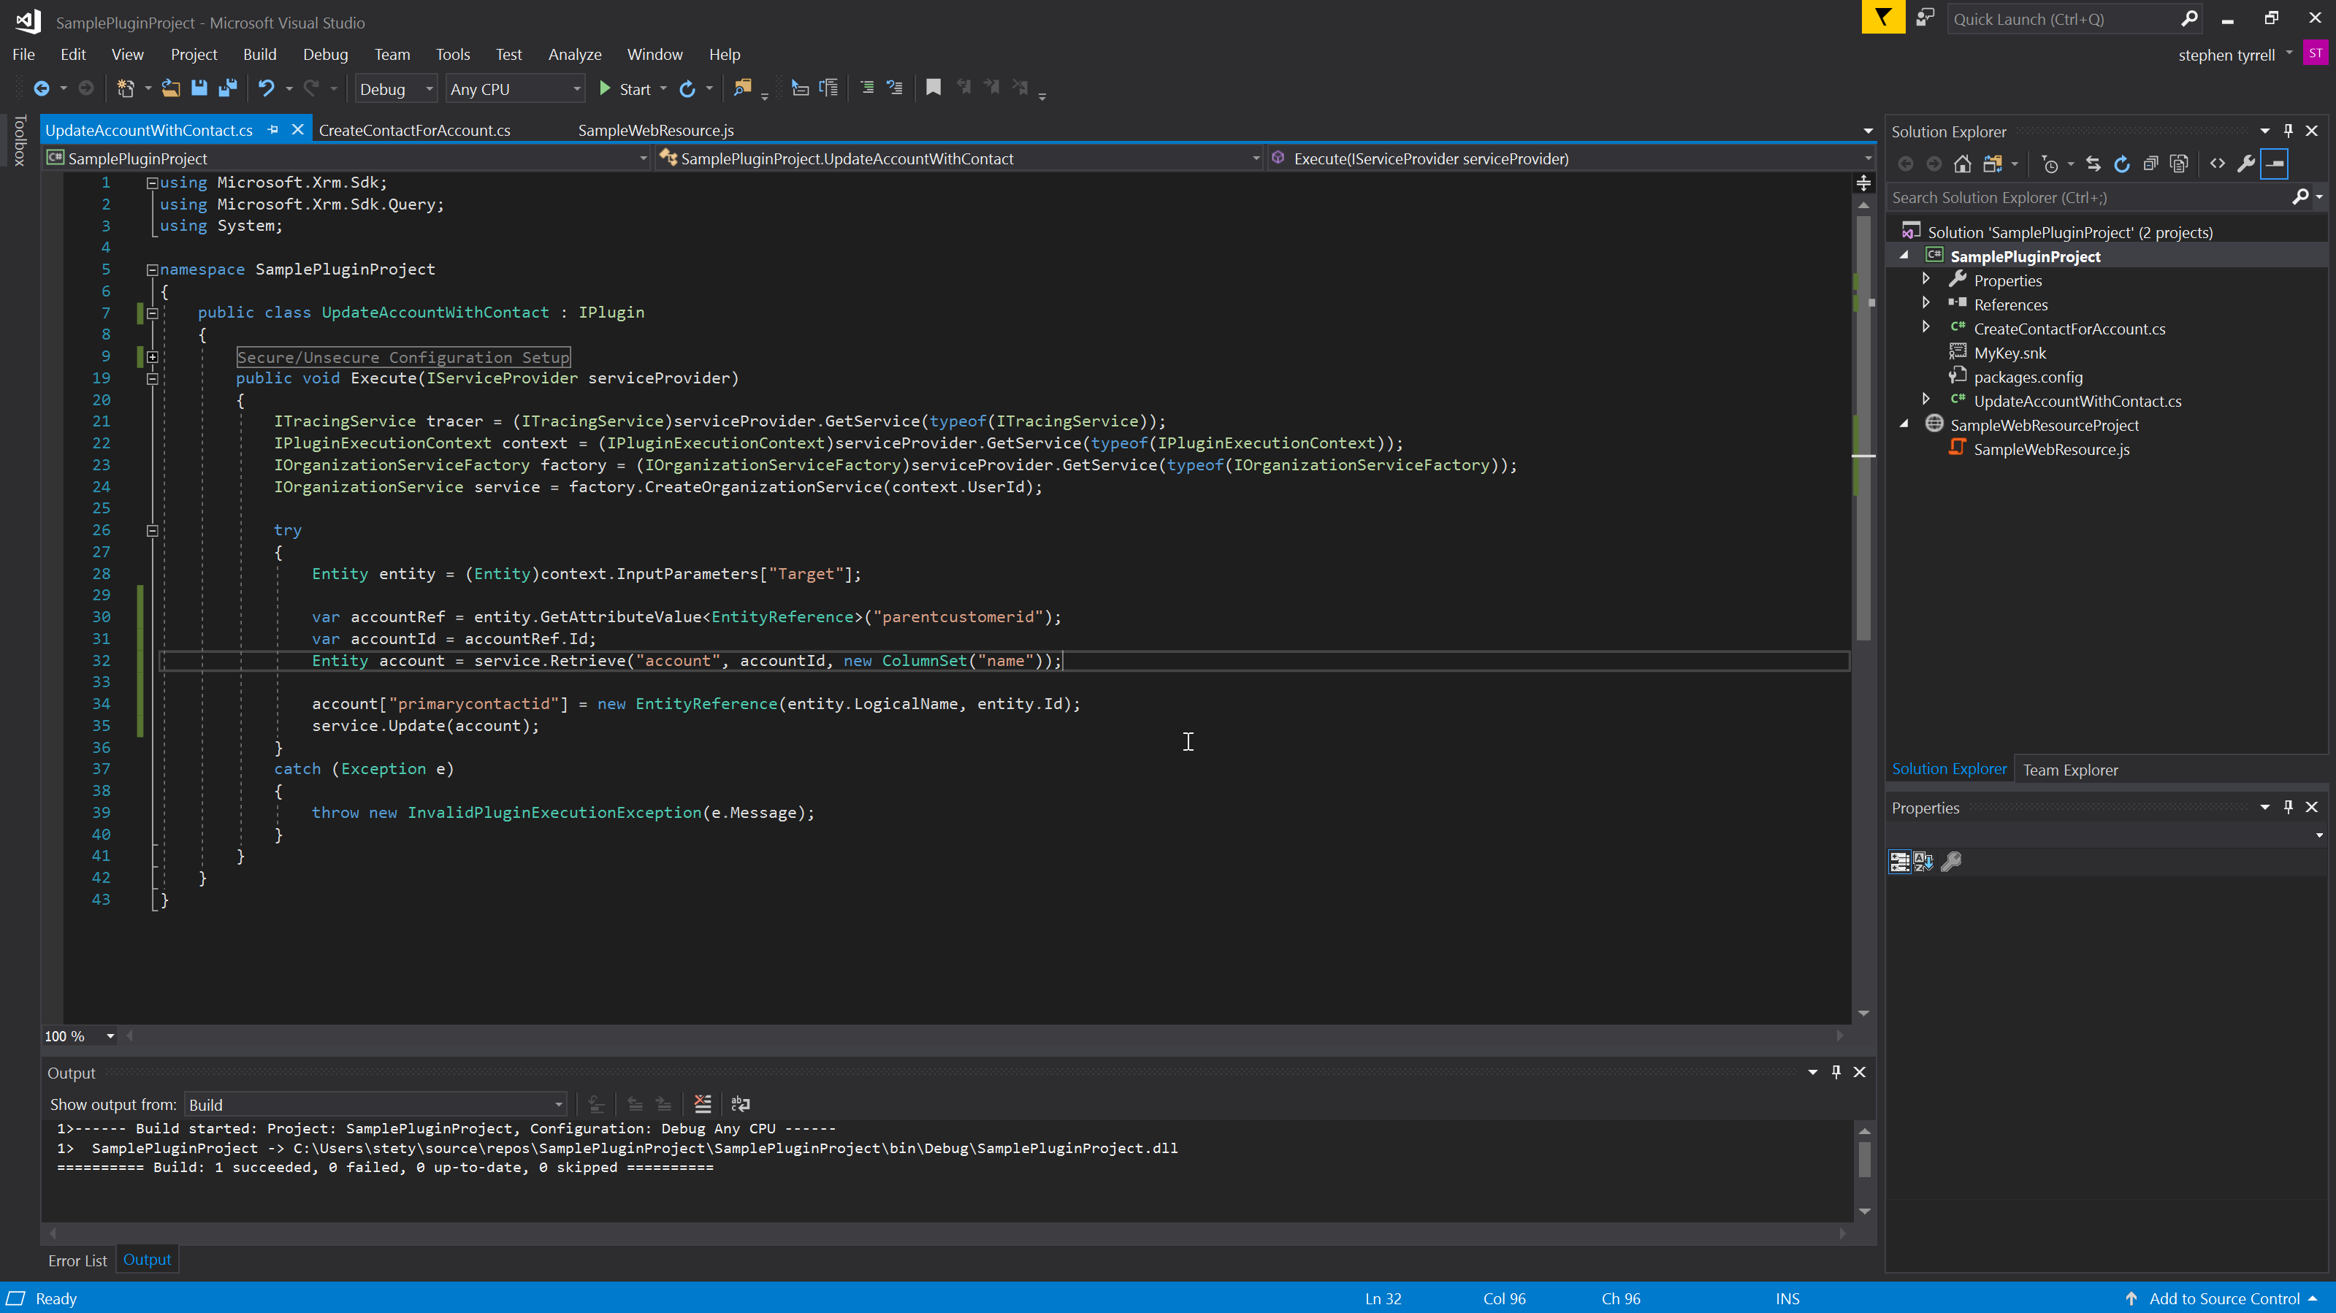

Slide 8
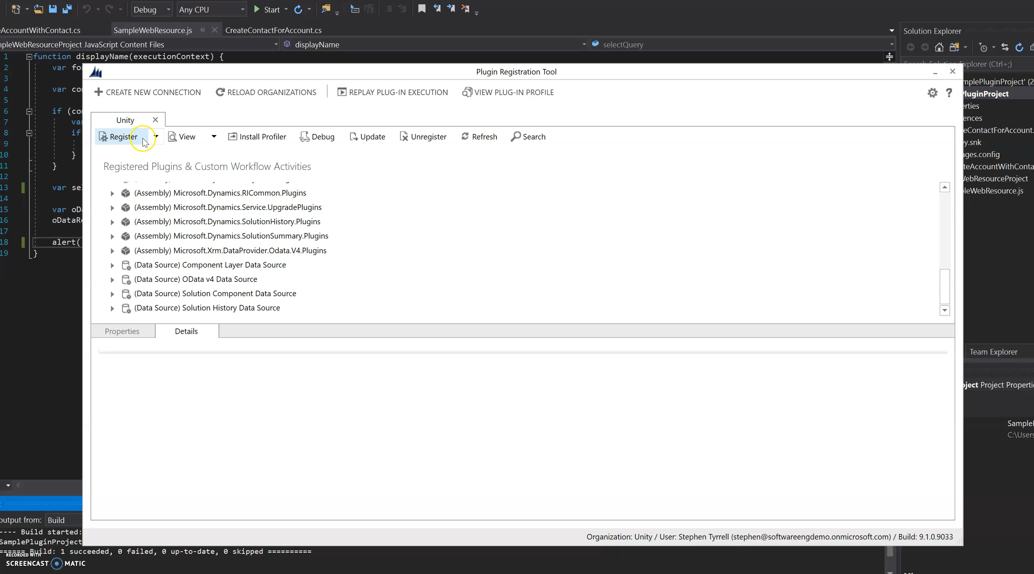

Slide 9
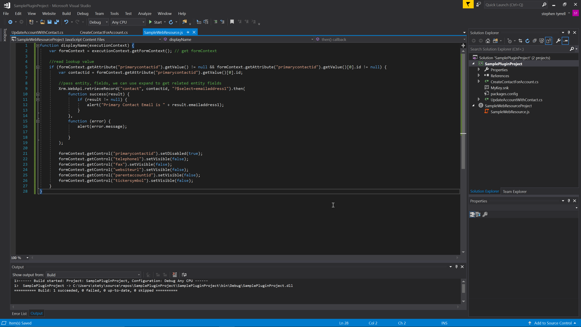

Slide 10
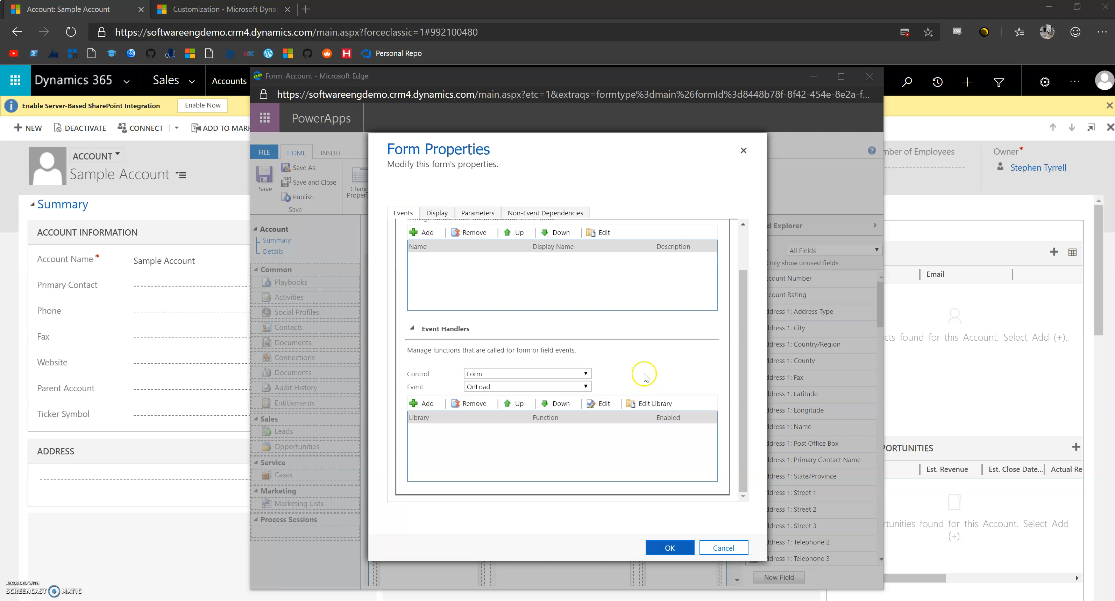

Slide 11
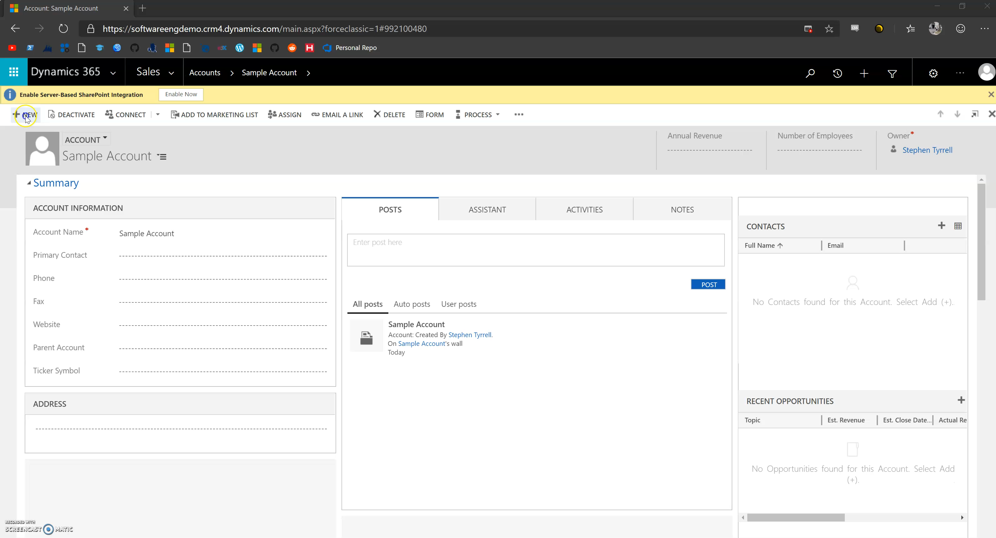

Slide 12
UseFul Links
Create a free online trial : https://trials.dynamics.com/
Review the Microsoft Developer Guide: https://docs.microsoft.com/en-us/dynamics365/customerengagement/on-premises/developer/overview
Attend a Power Platform meetup: https://www.meetup.com/PowerPlatform-UserGroup-Ireland/
Ask a member of the Unity Team/Platform Team any questions

